Slide 1

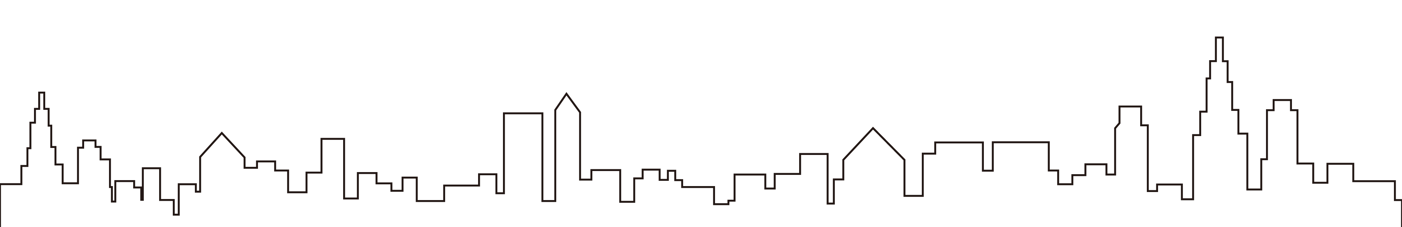
Pokémon Battle
An Augmented Reality Game
Presented by Group 9
03-Jan-2017

Slide 2

2
Presentation Contents
Make you understand what we are going to talk about next.
1
Team Members
2
Introduction of Pokémon Battle
3
Motivation
4
Work Process
5
Frustration
6
Future Work

Slide 3
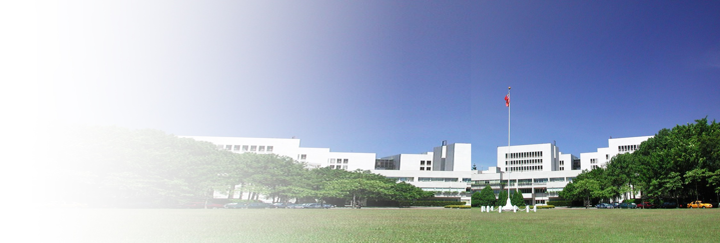

Who We Are
We all have different interests and expertise.
National Tsing Hua University
Industrial Engineering and Engineering Management
MS student

Slide 4





Meet Our Professional Team
We all have different interests and expertise.
He Ling Wang
Yu Wang Liu
Chien Jung Liao
Han Sheng Wu
Yu An Chen
Chief Executive Officer
Vice President
Project Supervisor
Game Development Engineer
Designer
Project Management
The God of Vuforia
Animation Design
Special Effects
Animation Design
Data Collection
Photographers
System Testing
Card/ PPT Design Visual Presentation

Slide 5

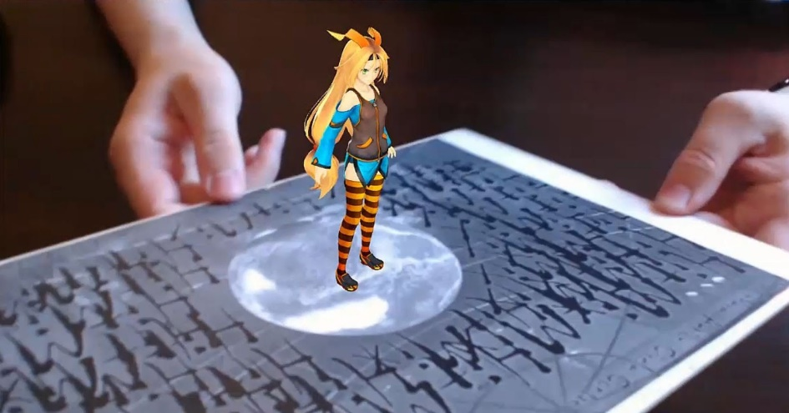
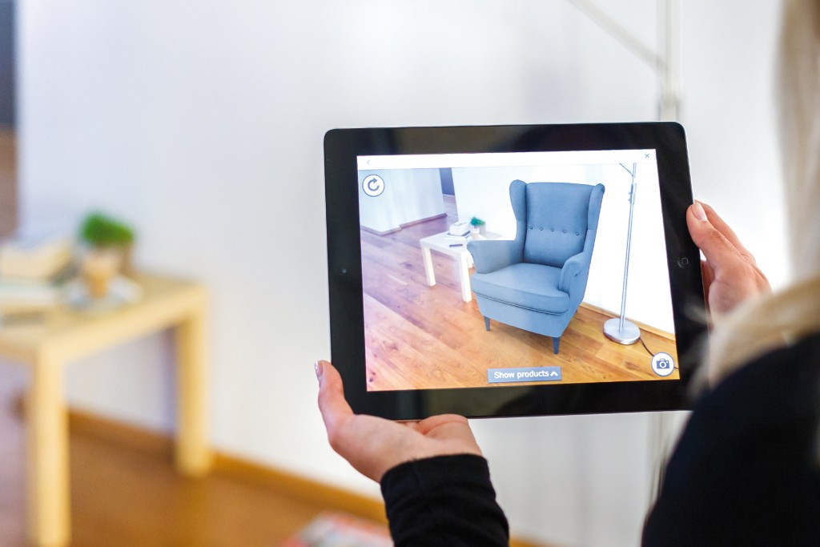

Introduction of Pokémon Battle
The concept and implementation of Pokémon Battle
Notes:
實現
趨勢(寶可夢熱潮、AR熱潮、手遊趨勢)

Slide 6


Training in Vuforia
Input Target
Recognition
Notes:
Recognition
Vuforia is an Augmented Reality Software Development Kit (SDK) for mobile devices that enables the creation of Augmented Reality applications. It uses Computer Vision technology to recognize and track planar images (Image Targets) and simple 3D objects, such as boxes, in real-time.

Slide 7










Integrating with Unity
STEP 3
STEP 2
Scripts PSS System
Design User Interface
STEP 1
STEP 4
Add Model & Animation
Build App
Notes:
截圖

Slide 8









Pokémon Cards Design
Pokémon Cards Unity
Show you how to make the Pokémon cards.

Slide 9

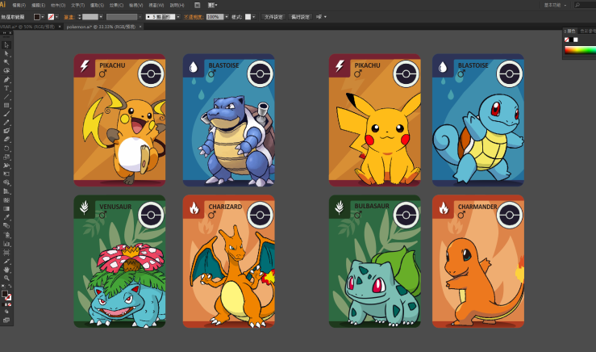
Pokémon Cards Design
Show you how to make the Pokémon cards.
Ai

Slide 10
DEMO

Slide 11





Our Motivation
Why do we choose to make this game?
Pokémon Boom
AR Technology
Mobile Game
Childhood Memory
Technology Trends
Notes:
我們一開始就決定要做”遊戲”作為期末報告主題
童年回憶
趨勢(寶可夢熱潮、AR熱潮、手遊趨勢)

Slide 12

Our Work Process
Let you know the framework of our project.
1
Concept & Idea
We had brainstorming and discussed many different types of game. Finally, the idea of “Pokémon Battle” came to our mind.
Notes:
這邊可以大概介紹一下我們本來的構想，像是蟑螂屋、坦克對戰 等等

Slide 13

Looking For Materials
2
We use the Internet to find the appropriate Pokémon model and related tutorials.

Slide 14



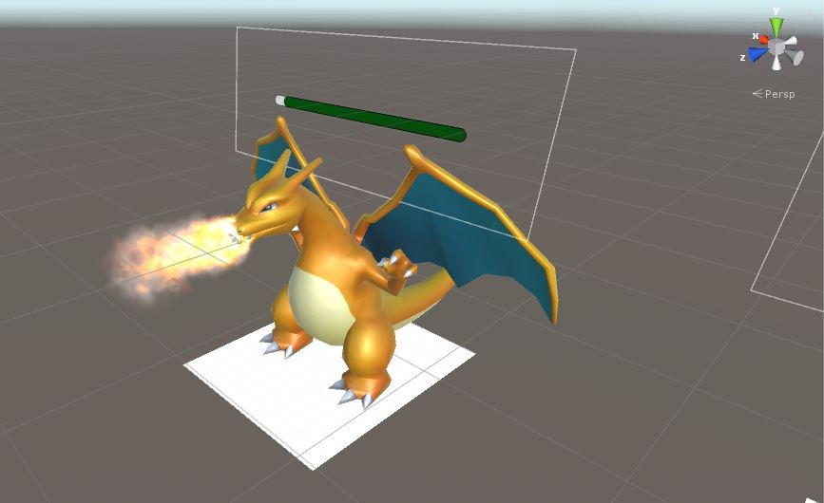
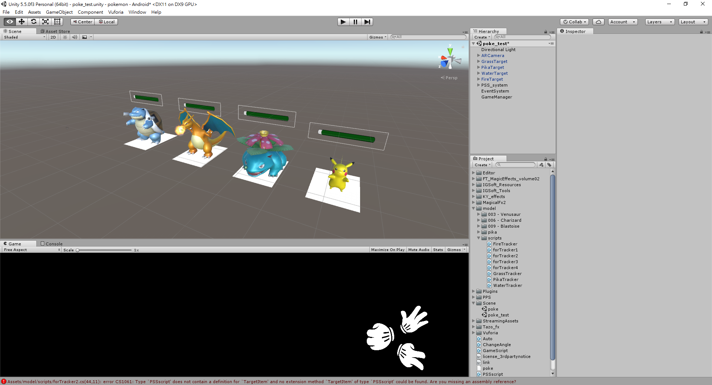
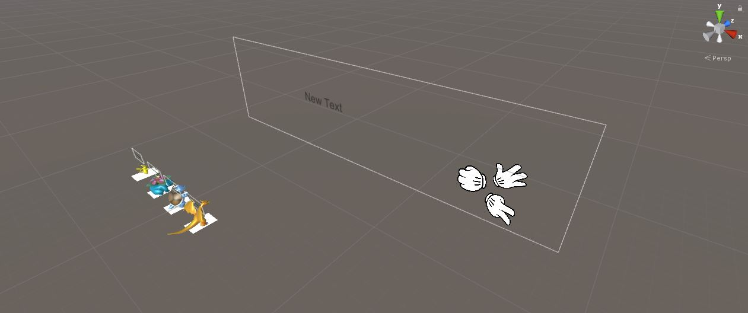

3
Design & Coding
Having different skills in various areas of expertise such as programming and designing, we work together to make the game completed.

Slide 15

4
Testing & Launch
During the production process, We kept testing and revising the game constantly to ensure the fluency and quality of the game.

Slide 16


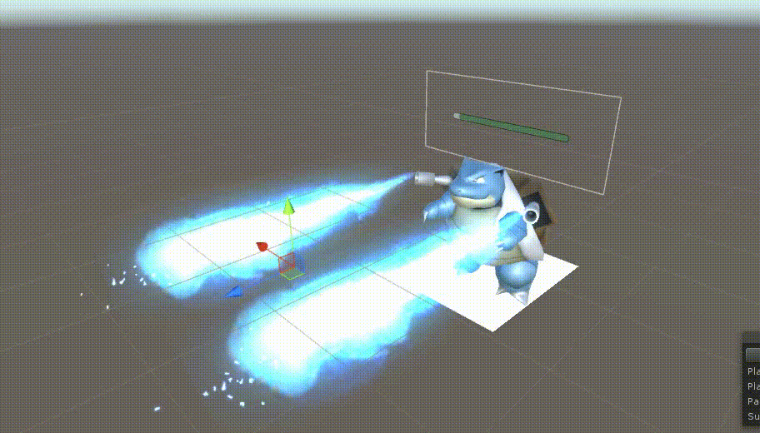
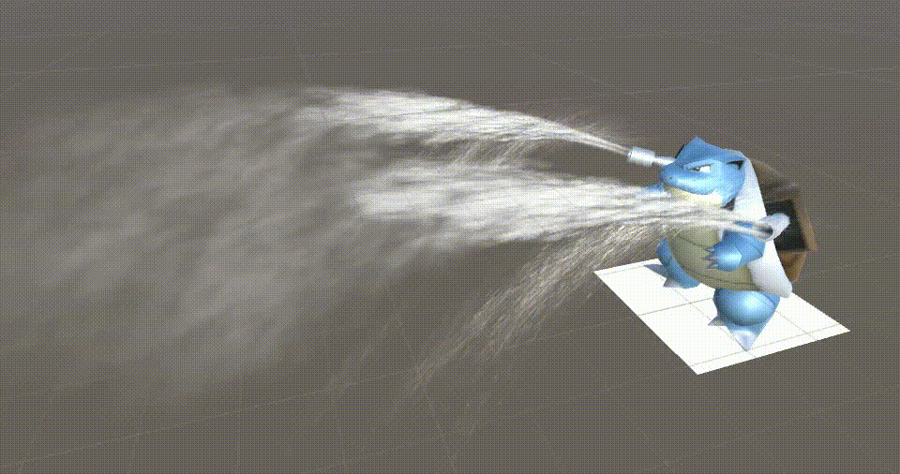
Some Frustration
Why we choose to make this game?
Hard To Find Special Effects
Notes:
特效素材很難找
Bug很難找
想像與現實的落差 : 有時難以達到我們想要的效果

Slide 17
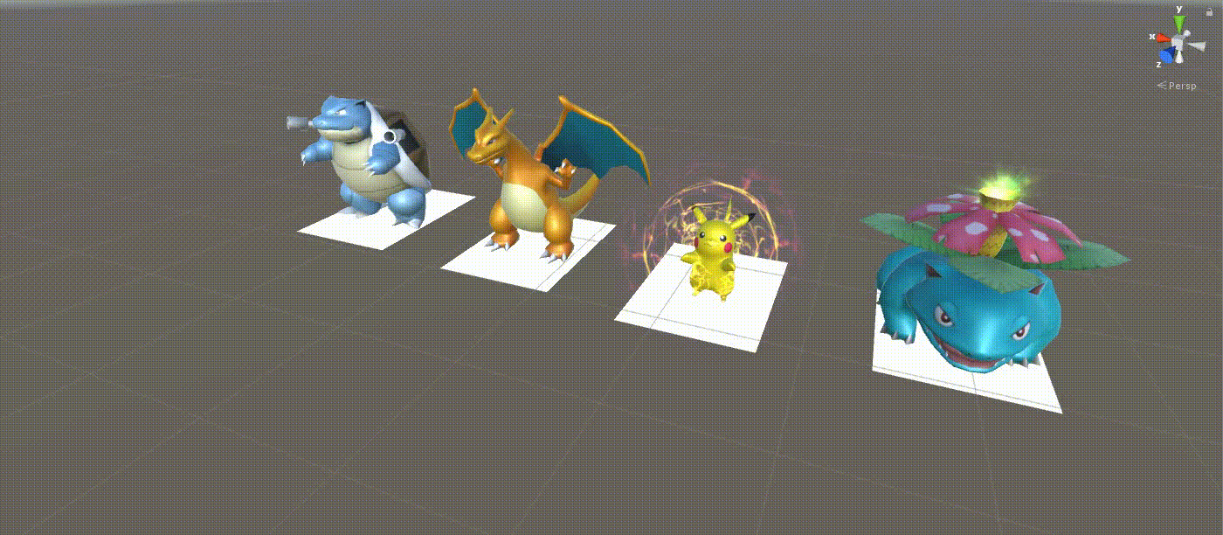
Some Frustration
Why we choose to make this game?
Hard To Find Special Effects
Notes:
特效素材很難找
Bug很難找
想像與現實的落差 : 有時難以達到我們想要的效果

Slide 18



Some Frustration
Why we choose to make this game?
Hard To Find Special Effects
Hard To Find Bugs
Gap Between Expectation And Reality
Notes:
特效素材很難找
Bug很難找
想像與現實的落差 : 有時難以達到我們想要的效果

Slide 19




Our Future Work
Why we choose to make this game?
03 Multiplayer
The Form of Multi-battle Can Let More People Play Together.
01 Increase the number
Make More Pokémon and Special Effects
02 Animation Optimize
More Detailed Motion
Vivid Expression, Lifelike sound
Notes:
做出更多神奇寶貝及特效
優化 : 動作更細緻與生動、表情到位、聲音
多人連線

Slide 20
Thanks For Your Listening

